Slide 1
Finnish National System of Innovation
Macovei Razvan

Slide 2
Agenda
Some figures
Stake-holders
R&D expenditures
Science and technology public choices

Slide 3
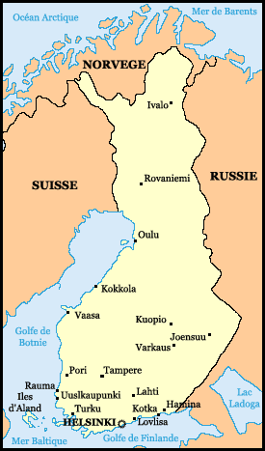
Some Figures
Area: 305,470 km².
Finland is heavily forested (69%) and contains numerous
lakes & rivers (10%).
Population (2006 est.):
5,2 million (growth rate: 0.1%).
Capital and largest city : Helsinki.
GDP (2004 est.): $151.2 billion.
Real growth rate: 3%.
Major trading partners:
Germany, Sweden, U.S., UK, Russia, Netherlands,
Denmark, France.

Slide 4
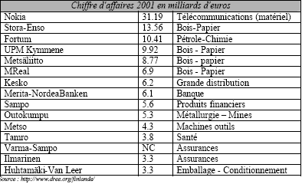
Some Figures
Labor force: 2.66 million;
  Public services 32%,
  Industry 22%
  Commerce 14%,
  Finance, insurance, and business services 10%,
  Agriculture and forestry 8%,
  Transport and communications 8%,
  Construction 6%
R&D : 3% of the Finnish GDP (2006).
National Champion Firms :

Slide 5
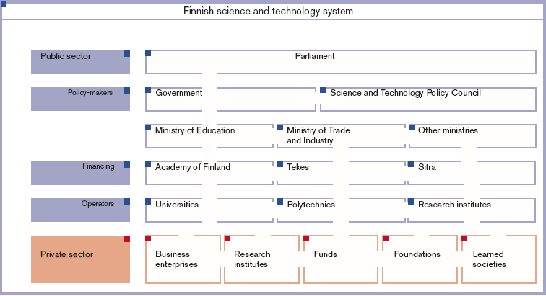
Stake-holders

Slide 6
Stake-holders
Academy of Finland: finance basic research and universities.
TEKES (National Technology Agency) :
  main public actor for financing applied research projects.
  2001 : 2 261 projects financed by TEKES with €387 millions.
SITRA (Independant Public Fund)
  Same role as TEKES but at a latter stage
VTT : applied research center
VTT is financed by the state (32%) and private contracts.
TEKEL : coordinates the activities of the Finnish Technological Parks

Slide 7
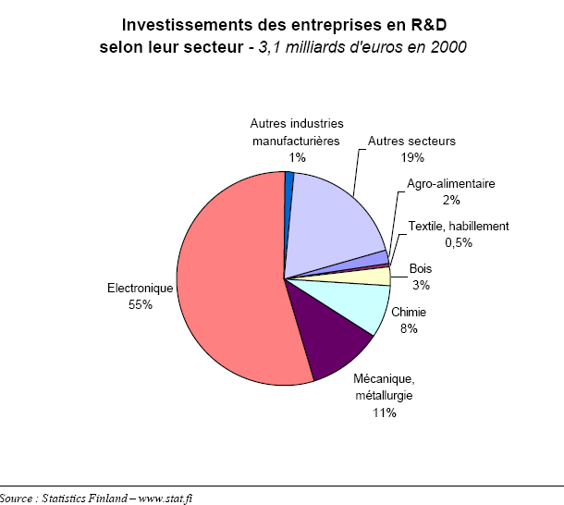
Stake-Holders
Businesses
Private expenditures by sector:

Slide 8
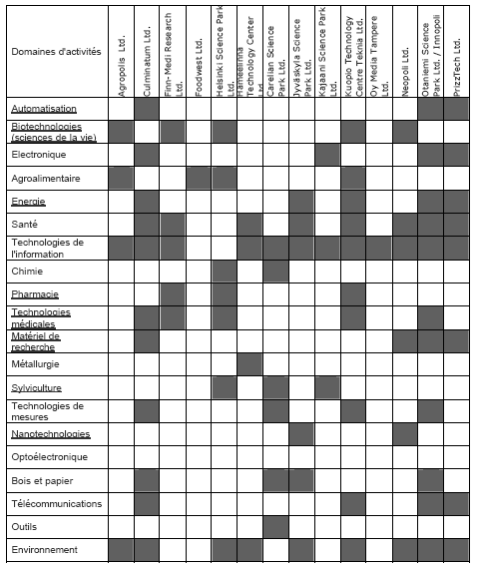
Stake-holders
  Prefered domains of research of Finnish Technological Parks
Number of patents per million inhabitants:
Sweden: 370
USA: 320
Finland: 300
Allemagne: 260
Japon: 250

Slide 9
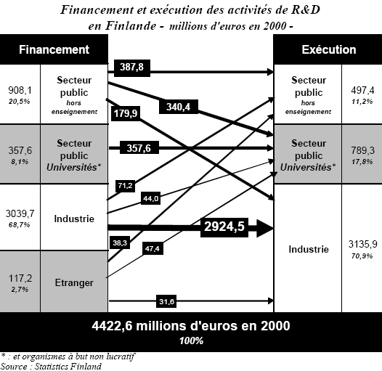
R&D expenditures

Slide 10
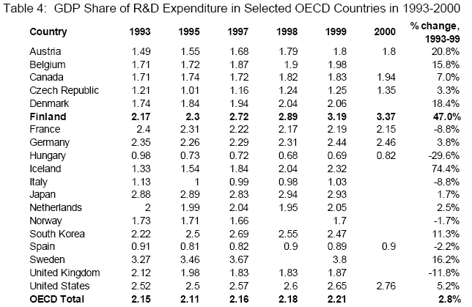
R&D expenditures

Slide 11
Science & Technology Public choices
Finnish science and technology policy is characterized by long-term development.
A national priority
A cluster-based approach with private & public actors.
A national coordination of the technology & Innovation policy
The general objective of the technology and innovation policy for 2004-07 is to promote economic growth and competitiveness of Finnish industry :
  increase financement of Technology.
  increase the effectiveness and cooperation between organisations supporting innovation.
  internationalisation of research, development and innovation activities.
  regional measures for a better use of the expertise available at the regional institutions.

